Slide 1
How Does Big Data Help Investment Decision
Ken Liu

Slide 2
Agenda
Big and Alternative Data
Examples
Portfolio: Sentiment Applications
Trading: Social, Reinforcement
Experience Sharing
Datatact
AI trading

Slide 3



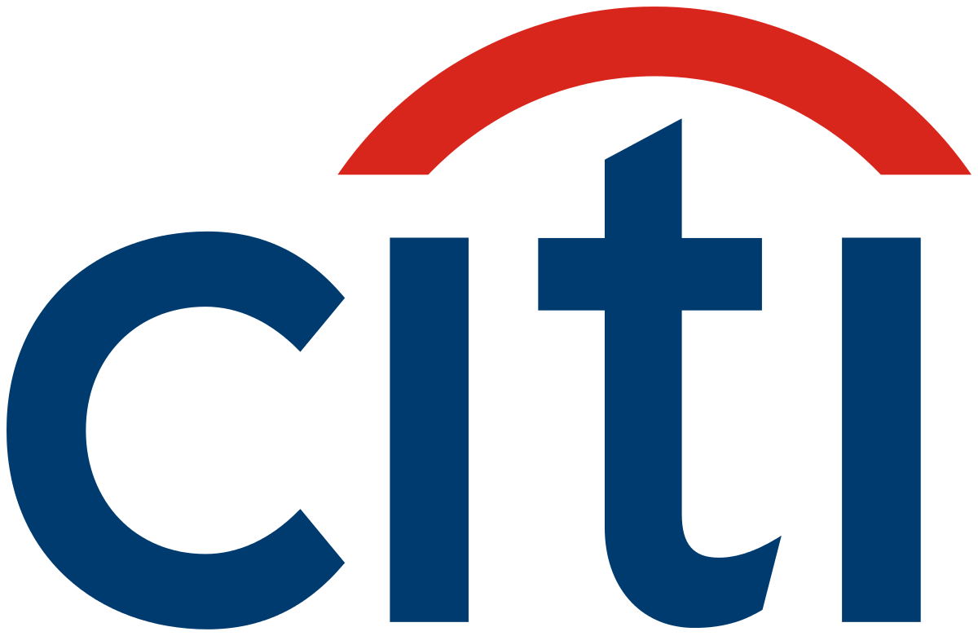


My Background
Study Computer Science
iBanks Algo trade technologist
Startup on Quant Trading, Big Data and AI

Slide 4
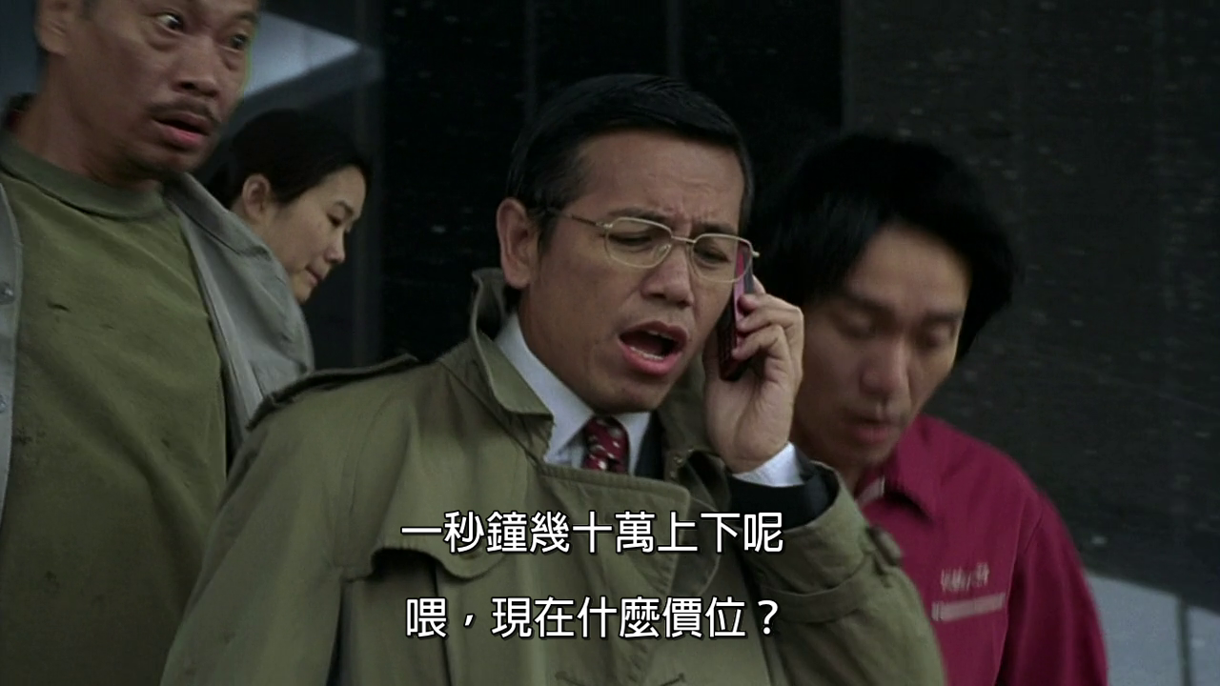
My Work
Sub-header/text/chart/table

Slide 5
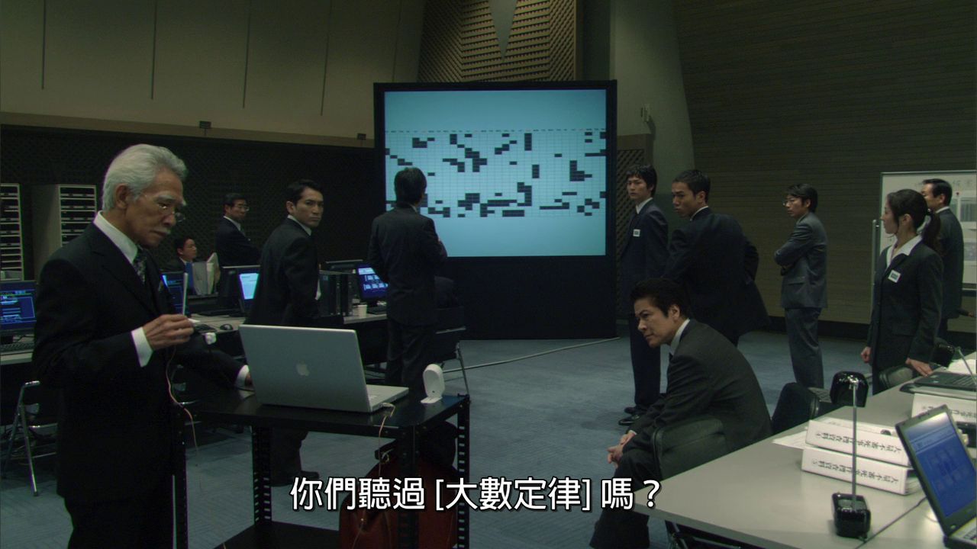
My Work
Sub-header/text/chart/table

Slide 6

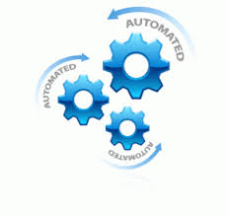
Key Themes
Portfolio (what do buy)
Stock Pickings
Fundamental: values, prospects
Quantitative: statistics, models
Trading (how to buy)
Algorithmic Trading
HFT (High Frequency Trading)
Program Trading

Slide 7
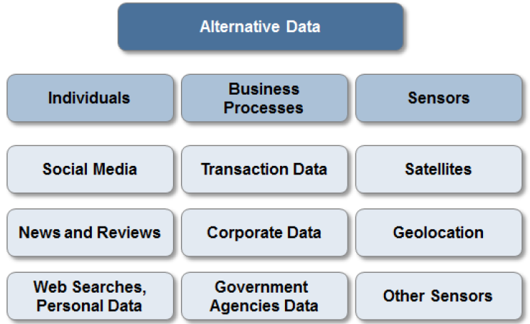
Data, Data, Data….

Slide 8
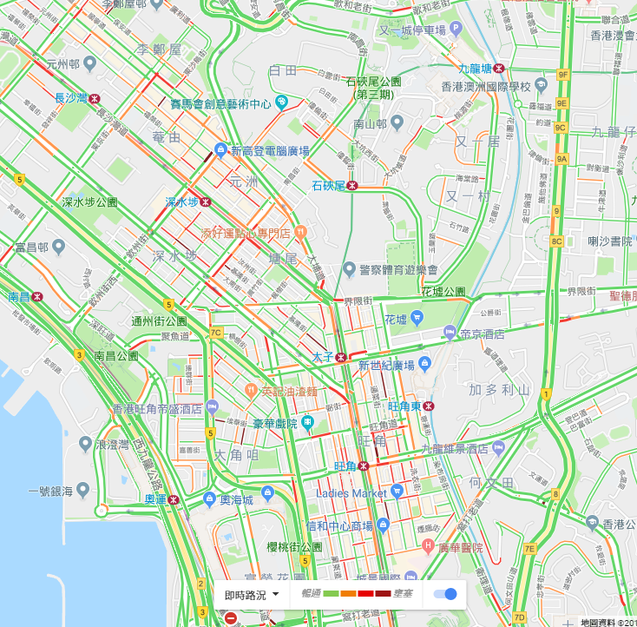
Individuals: Digital Footprints
Mobile Data (GPS): Google Map traffic analyzing the GPS-determined locations transmitted to Google by a large number of mobile phone users. By calculating the speed of users along a length of road, Google is able to generate a live traffic map https://en.wikipedia.org/wiki/Google_Traffic
Web search trend https://trends.google.com/trends/
Social Media: Facebook, Twitter etc
Personal email http://www.superfly.com/

Slide 9
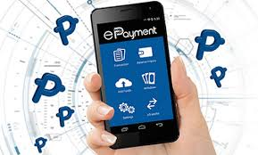
Business Processes
Public agencies (e.g. federal and state governments) https://data.gov.hk/en/
Commercial transactions (including e-commerce such as AliPay and WeChat, credit card spending, exchange transaction data)
Private agencies (e.g. industry specific supply chain data, intra-day tick data from the exchange)
Other ideas:
Amazon: track the best sales products and break down the underlying raw material for investing
Gov open data (such as pollution index, beach water quality): track health for pharmaceutical stocks

Slide 10
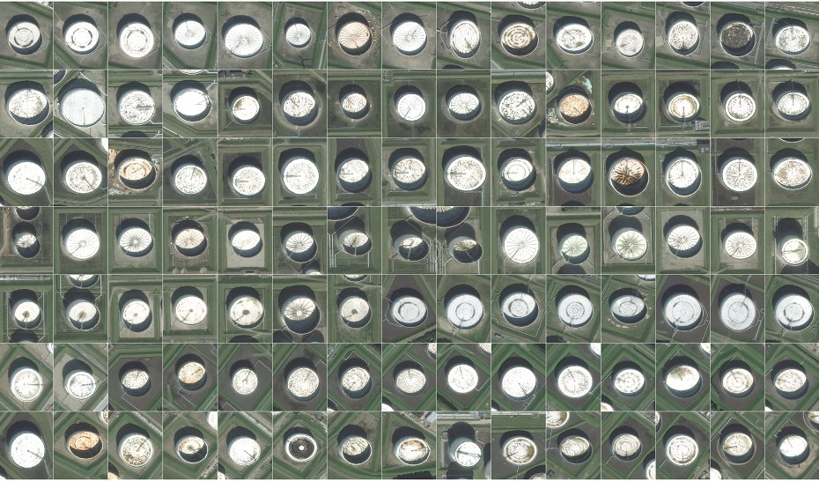
Satellite image: Oil Reserve
Oil reserves are often stored in floating tanks around the world, whose lid rises and falls with increasing or decreasing storage. With the rising and falling height, the crescent-shaped shadows cast by the sun also change shape. By tracking these shape changes (Deep Learning - CNN), Orbital Insights predicts oil inventory levels. https://www.wired.com/2015/03/orbital-insight/

Slide 11
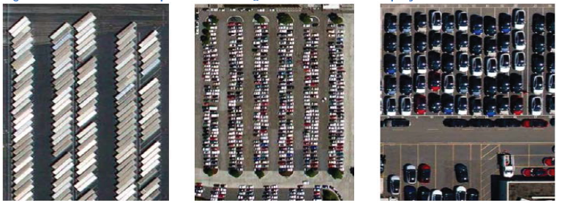
Satellite image: Parking Lots
Satellite Imagery of Parking Lots and Trading Retail Stocks from RS Metrics - uses ~10 high-resolution satellites, orbiting the Earth and imaging between the store opening hours. Such data can be used to estimate retail traffic (e.g. at some ~50 retail chains)
Other Ideas:
Road cameras (video) to gauge car brands popularity
In class students facial expressions to predict the class effectiveness

Slide 12
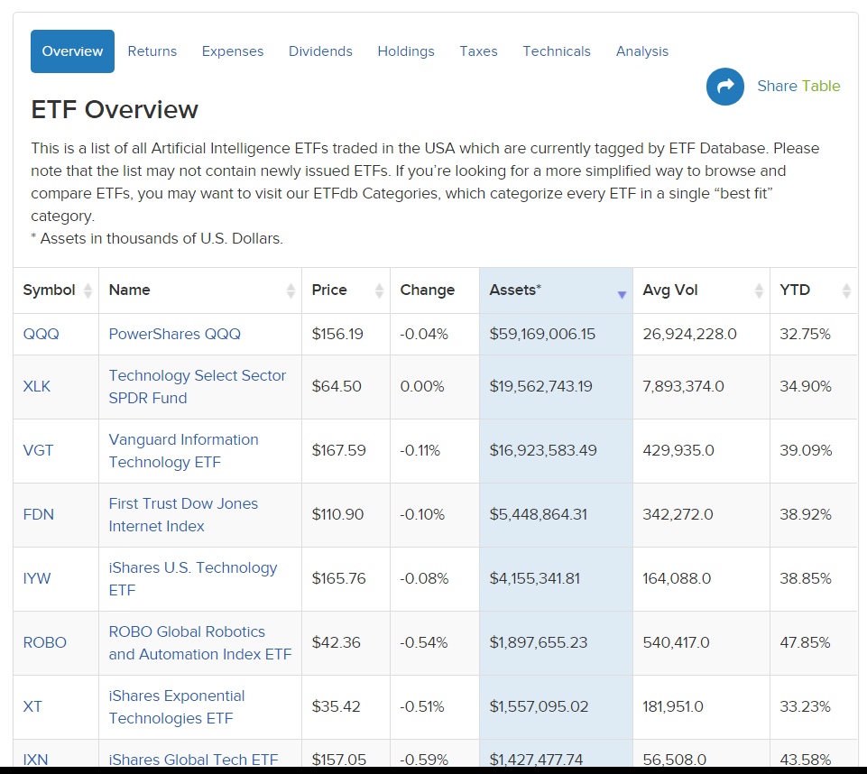
Robo-Advisor: AI ETF
Leverage big & alternative data source
Text: Social Media, News
Images: satellite image on oil fields
Videos: road cameras of cars

Slide 13
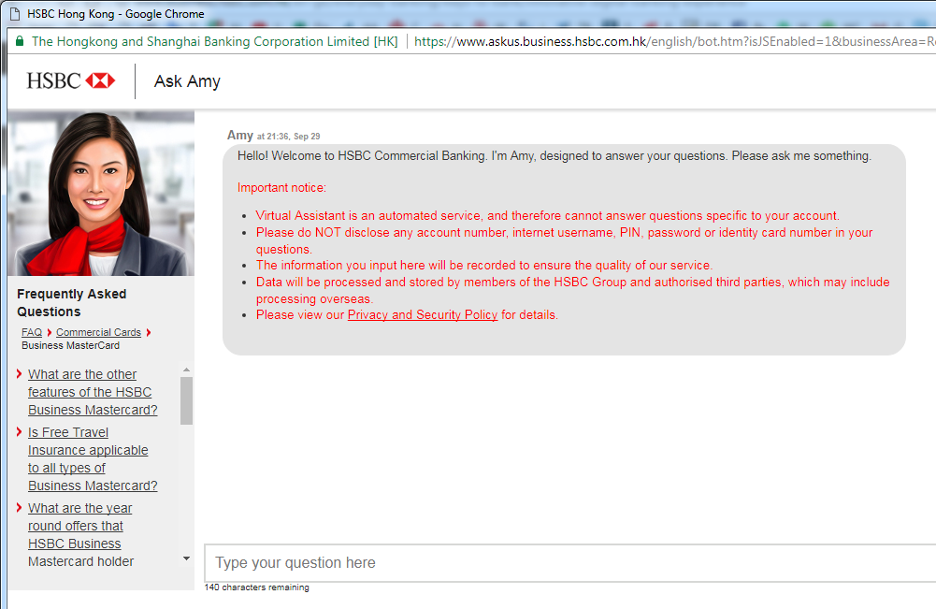


Example: Customer Experience
HSBC Amy: Chatbot
Manulife Move
AXA Xtra

Slide 14
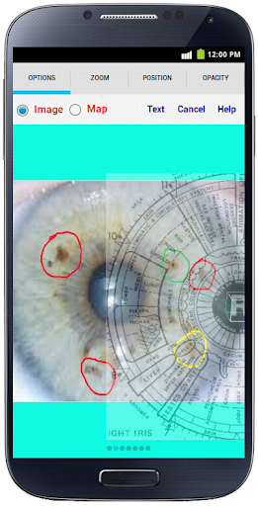
Example: Personal Health
Iridology: BiliScreen uses a smartphone camera, computer vision algorithms and machine learning tools to detect increased bilirubin levels in a person’s sclera, or the white part of the eye
https://www.alliancehealth.org.nz/tech-talks/data-digital-ai-app/app-uses-smartphone-selfies-to-screen-for-pancreatic-cancer
https://www.researchgate.net/publication/262876553_The_Smart_Device_for_Healthcare_Service_Iris_diagnosis_application

Slide 15
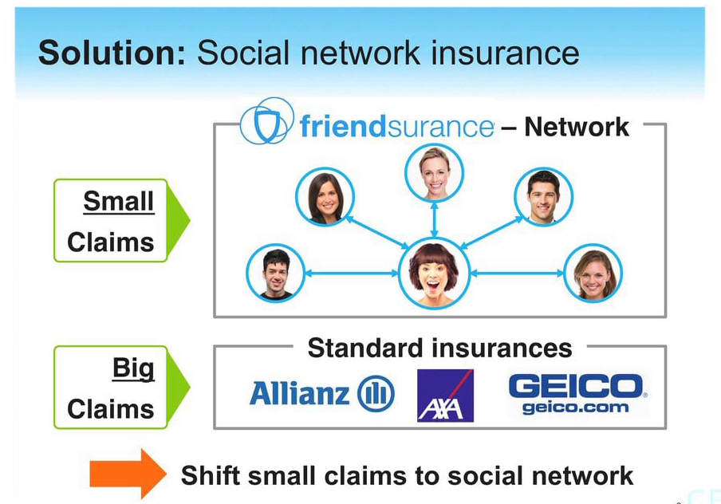
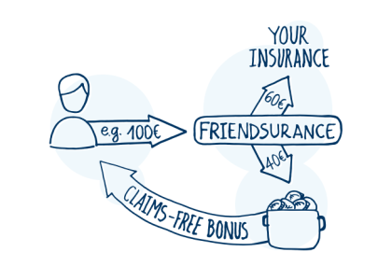
Example: P2P Insurance
Friendsurance: P2P Insurance. “If there are zero or just a few claims, the members of the group receive a share return from the cashback pool. Insurance customers enjoy full coverage and never pay more than they would.

Slide 16
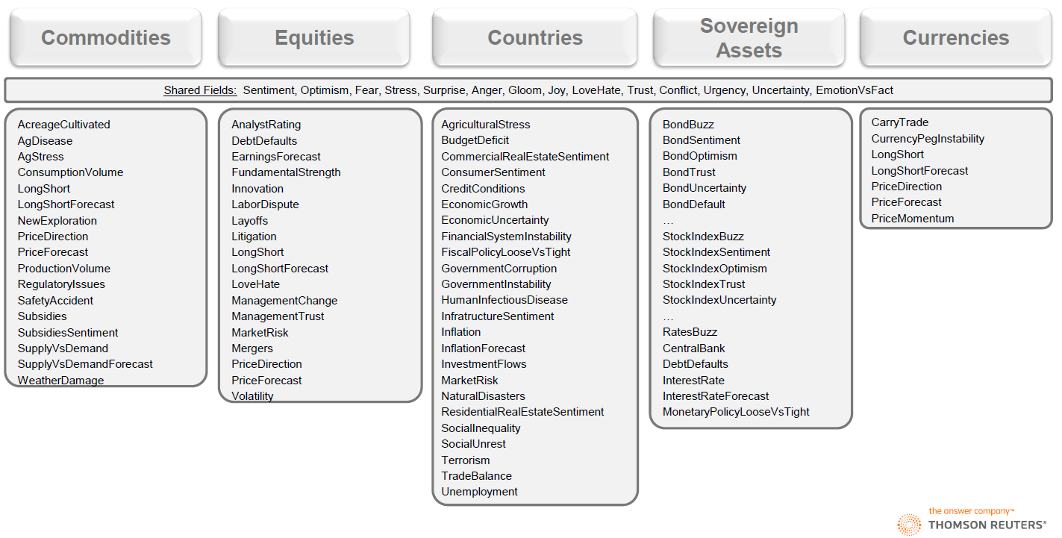
Thomson Reuters MarketPsych Indices (TRMI)

Slide 17
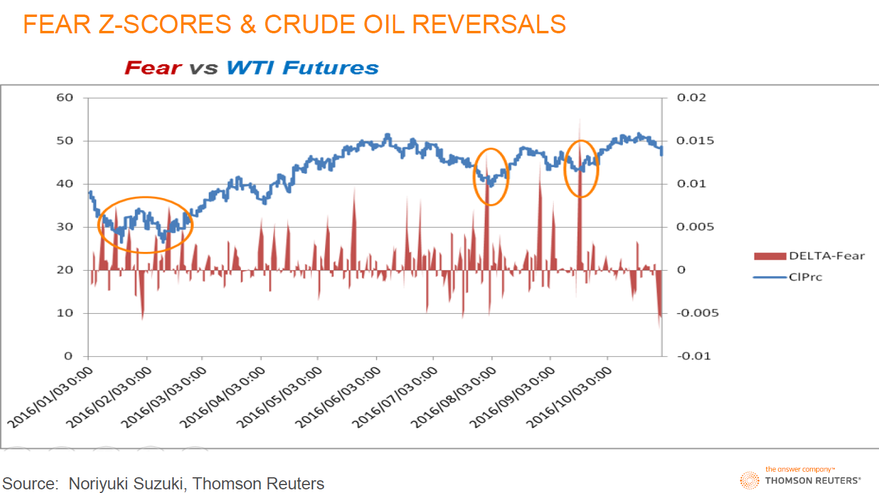
Thomson Reuters MarketPsych Indices (TRMI)

Slide 18
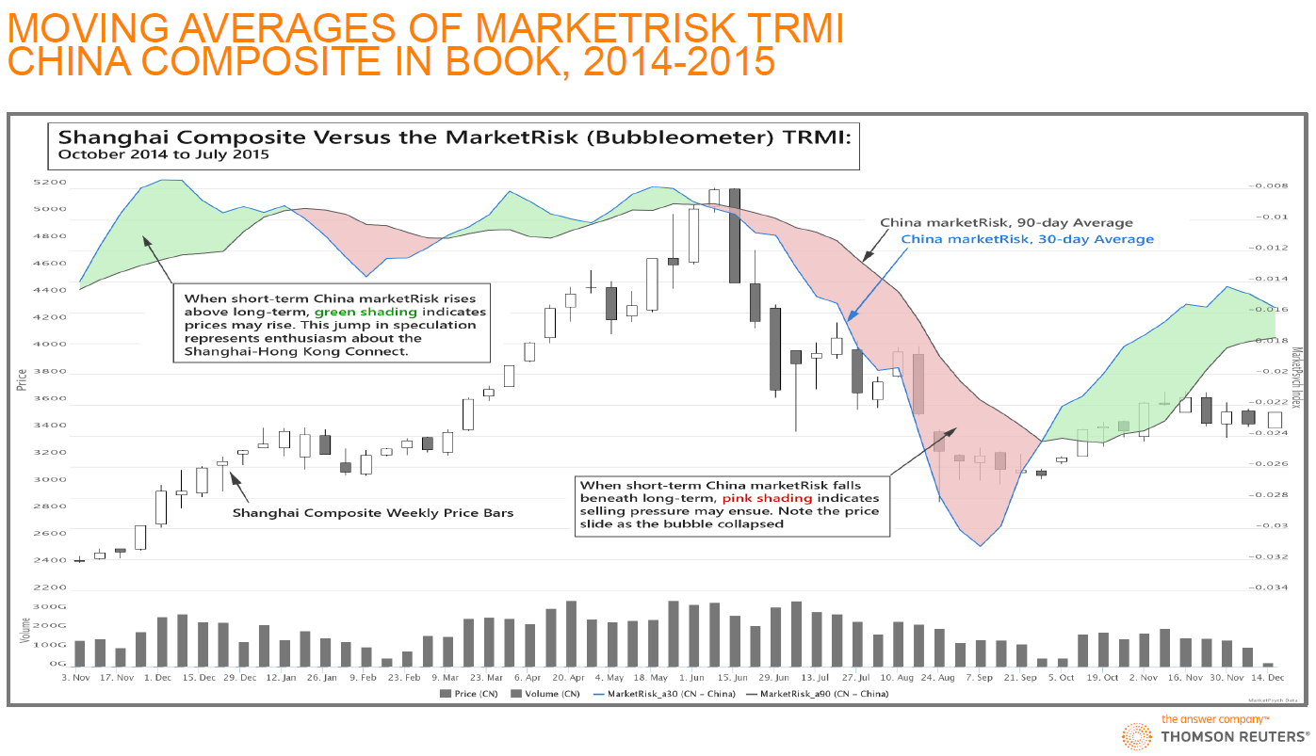
Thomson Reuters MarketPsych Indices (TRMI)

Slide 19
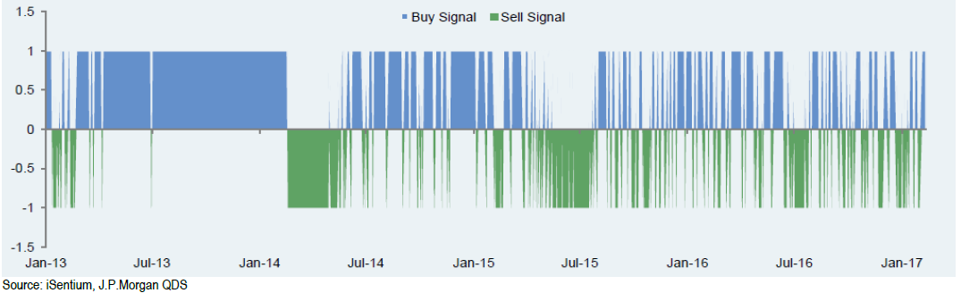
Equity Long/Short: Twitter Sentiment
The universe is limited to the 100 stocks which are most representative of the S&P 500, filtered using tweet volume and realized volatility measures.
Tweets are assigned a sentiment score using a NLP algorithm.
By aggregating tweet scores, a sentiment level is produced per minute between 8:30 AM and 4:30 PM every day.
Sentiment for the day is aggregated using an exponentially weighted moving average over the past ten days.

Slide 20
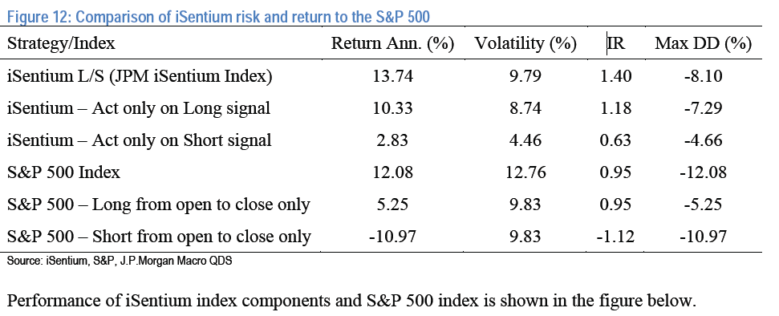
Equity Long/Short: Twitter Sentiment
IR = Information Ratio; Max DD% = Max Draw Down%
Period is from 2013 to 2017 and why Long Signal is more profitable

Slide 21
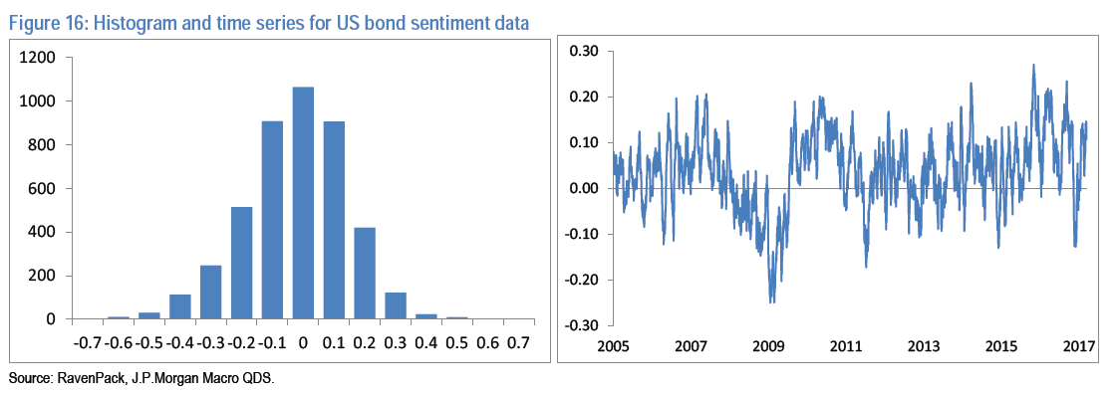
Bonds Long/Short: Economic Sentiment
Sovereign Bonds
A daily long-short strategy is constructed from currency-hedged returns of sovereign bonds from Australia, Canada, Denmark, Germany, United Kingdom, Japan, Sweden, New Zealand and the United States.
RavenPack does not issue a ‘bond sentiment’ indicator; so used economic sentiment as a contrarian indicator; we go long the 3 bonds with the most negative economic sentiment and short the 3 with the most positive sentiment.

Slide 22
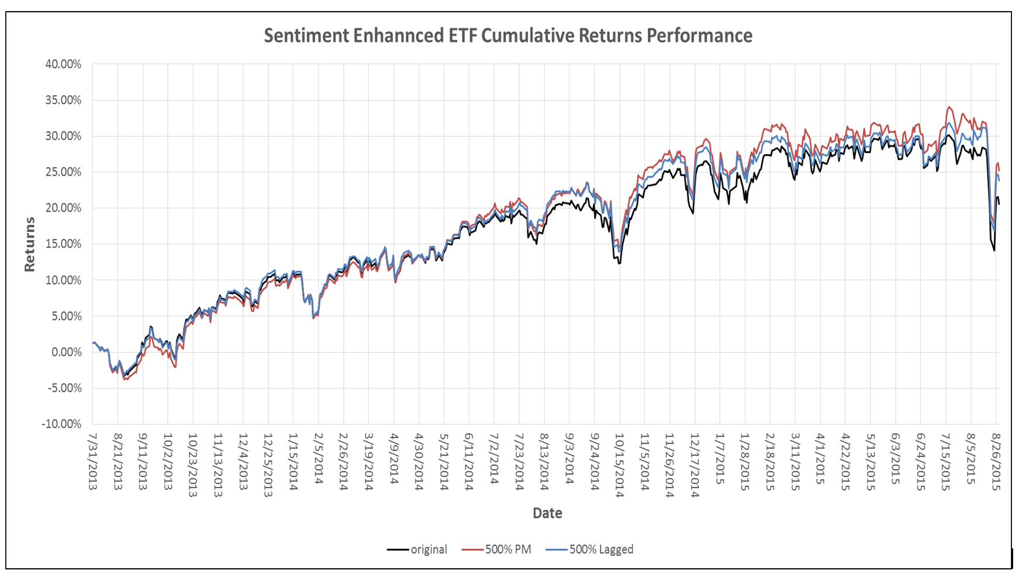
Smart Beta: Sentiment Enhanced ETF
Using the social media sentiment levels of individuals ETF constituents to rebalance the weights of the constituents in the ETF while keeping the Assets under Management constant
https://socialmarketanalytics.wordpress.com/2015/10/27/social-media-and-smart-beta/

Slide 23
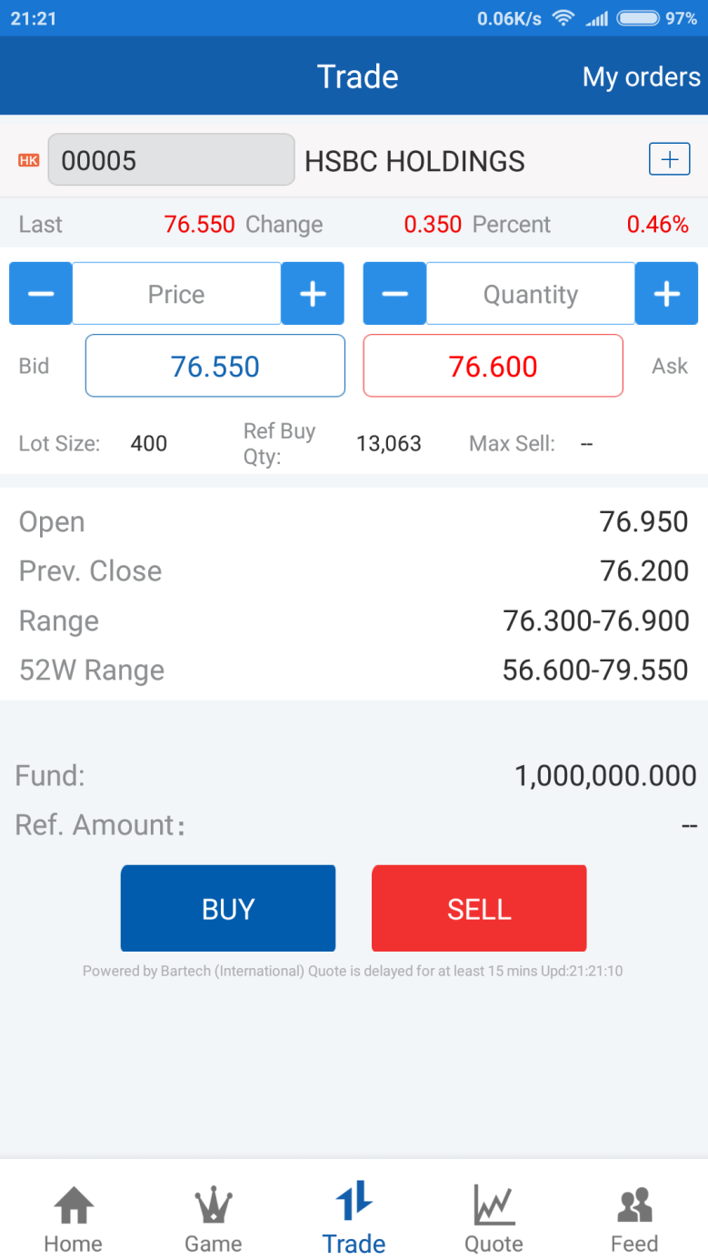
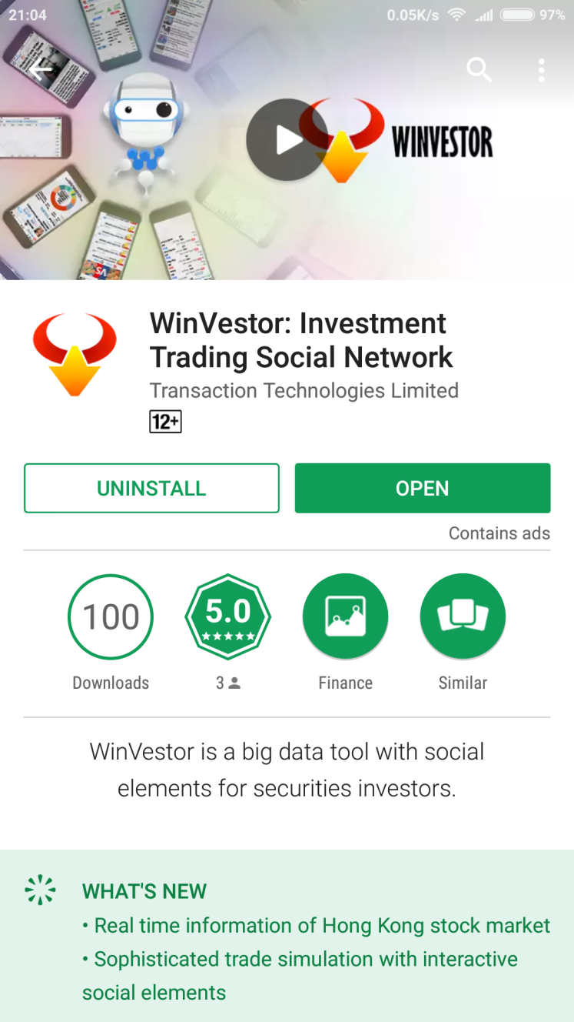
Social Trading
WinVestor
Download from App or Play Store
News Analytics
Market Data
Trading Games

Slide 24
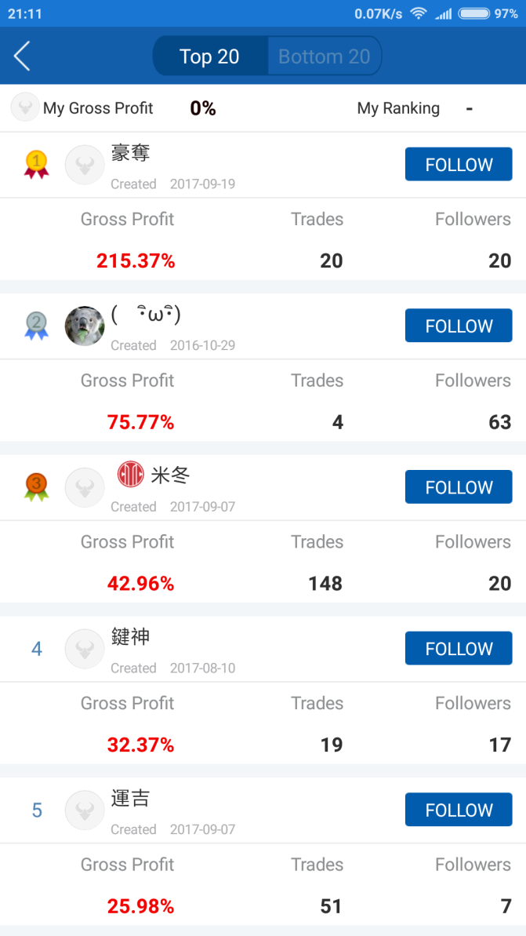
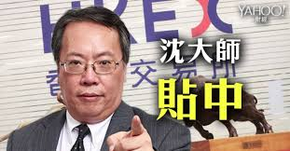
Social Trading
Learn user trading patterns and behaviors
Money-making users can get paid for viewing their profitable portfolios and transaction notifications

Slide 25
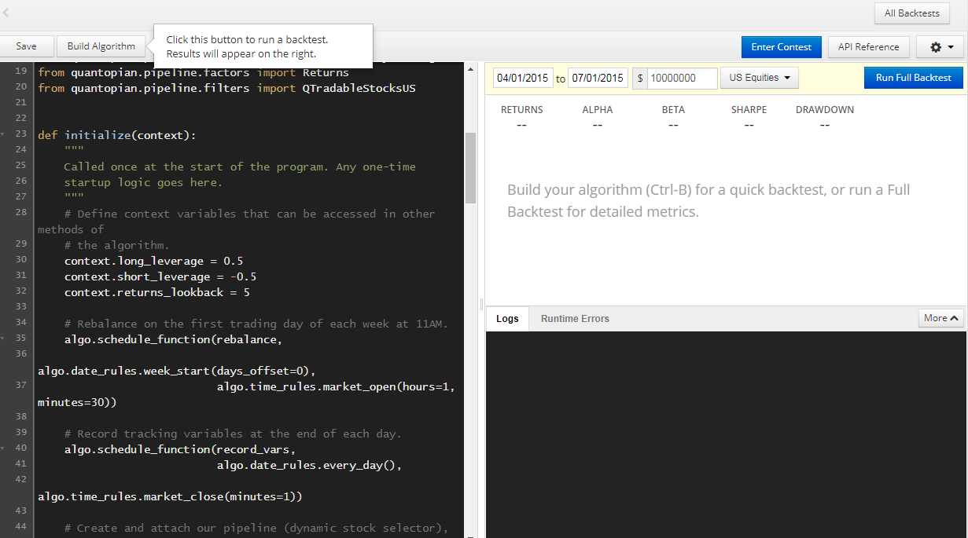
Crowd Quant & Research
Quantopian: https://www.quantopian.com

Slide 26
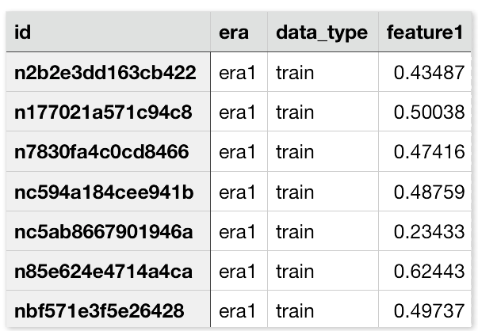
Crowd Quant & Research
Numer.AI: https://numer.ai/learn
No data scientist has a machine learning model that is better than all the others
Not a search for the ‘best’ model; it is a platform to synthesize many different models with many different characteristics
Collaboration to build the meta model
Reward with cryptocurrency
三個臭皮匠，勝過一個諸葛亮 (3 idiots are better than one smart guy) ?

Slide 27
Short Term Price Movement
Order Book Imbalance: the average ratio between the best bid and best ask size over a 1-min window. If the average bid size is larger than the ask size (hence a positive ratio), like the example below, it indicates the price is more likely to go up. Vice versa, the price is more likely to go down.
1min-Order Book-Imbalance = Avg (Log(Best BidSize/ Best AskSize))
Options: We can take into account the first few levels (for example 3 levels) of the order book while the top level of the book will have higher weighting. The 1-min duration can also be customized to a shorter or longer duration.
Size | Bid | Ask | Size
1,000,000 | 9.5 | 9.6 | 20,000
500,000 | 9.4 | 9.7 | 50,000
700,000 | 9.3 | 9.8 | 80,000
Notes:
Ask why taking log – because the asymmetry of +ve and –ve ratio

Slide 28
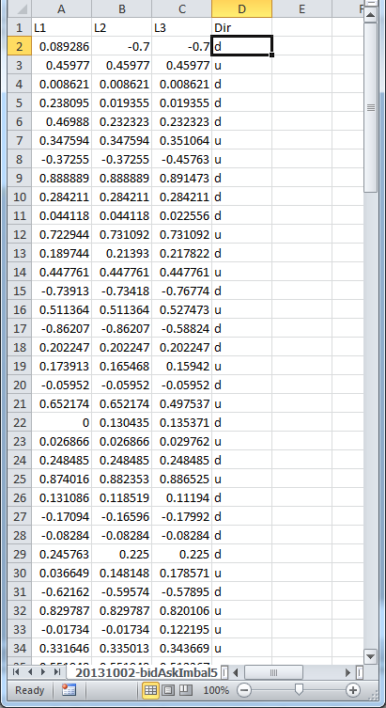
Short Term Price Movement
Use Decision Tree to predict short-term stock (5.HK) movement (go up or down) from Order Book Imbalance (OBI) data.
L1: Level-1 OBI
L2: Level-2 OBI
L3: Level-3 OBI
Dir: Direction - u(up) , d (down)

Slide 29
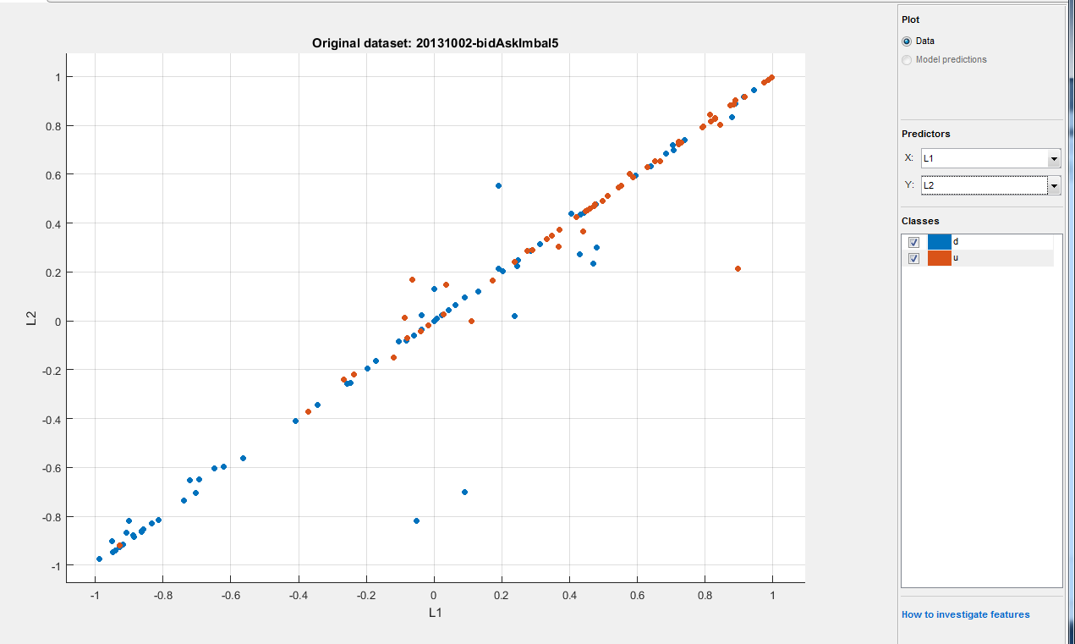
Short Term Price Movement
Visualize the data: plotting Level-1 OBI and Level-2 OBI
Brown dots: stock going up, Blue dots: stock going down
More Brown dots (up) when both Level-1 OBI and Level-2 OBI are positive and vice versa

Slide 30
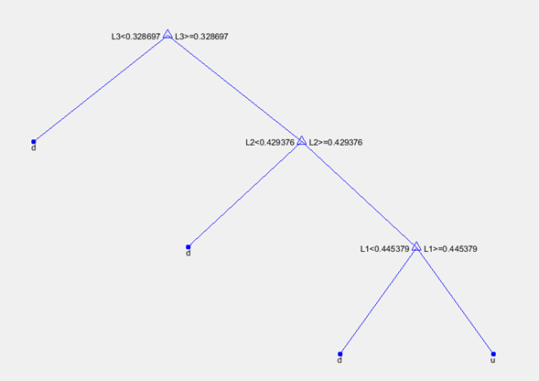
Short Term Price Movement
Decision Tree training results for this Stock to be more likely to go up when:
Level-1 OBI > 0.445379 and Level-2 OBI > 0.429376 and Level-3 OBI > 0.328697

Slide 31
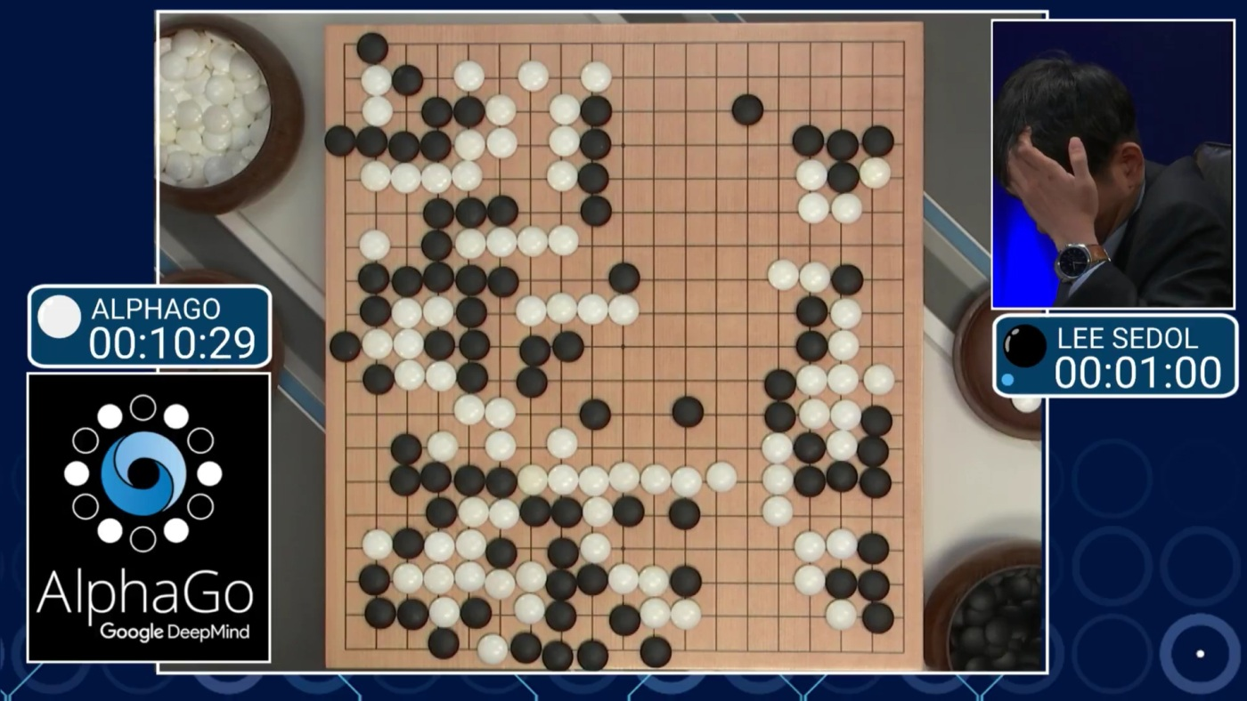
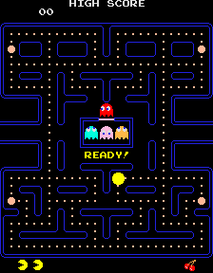
Reinforcement Learning
Alpha Go Netflix Vidoe in Youtube

Slide 32

Reinforcement Learning
Software agents to take actions in an environment so as to maximize some notion of cumulative reward to achieve the objective.
The feedback (rewards or punishments) can be delayed.
Explore vs. Exploit: should the algorithm explore new alternative actions that may maximize the final reward, or stick to the established one that maximizes the immediate reward.
Value learning (state, values) vs Policy learning

Slide 33
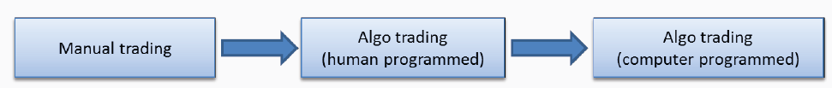
Reinforcement Learning Application
Example of Reinforcement Learning based Algo Trading System
JP Morgan LOXM
http://www.smallake.kr/wp-content/uploads/2017/08/Active-Learning-in-Trading-Algorithms.pdf
ITG ISai (Implementation Shortfall Artificial Intelligent)

Slide 34
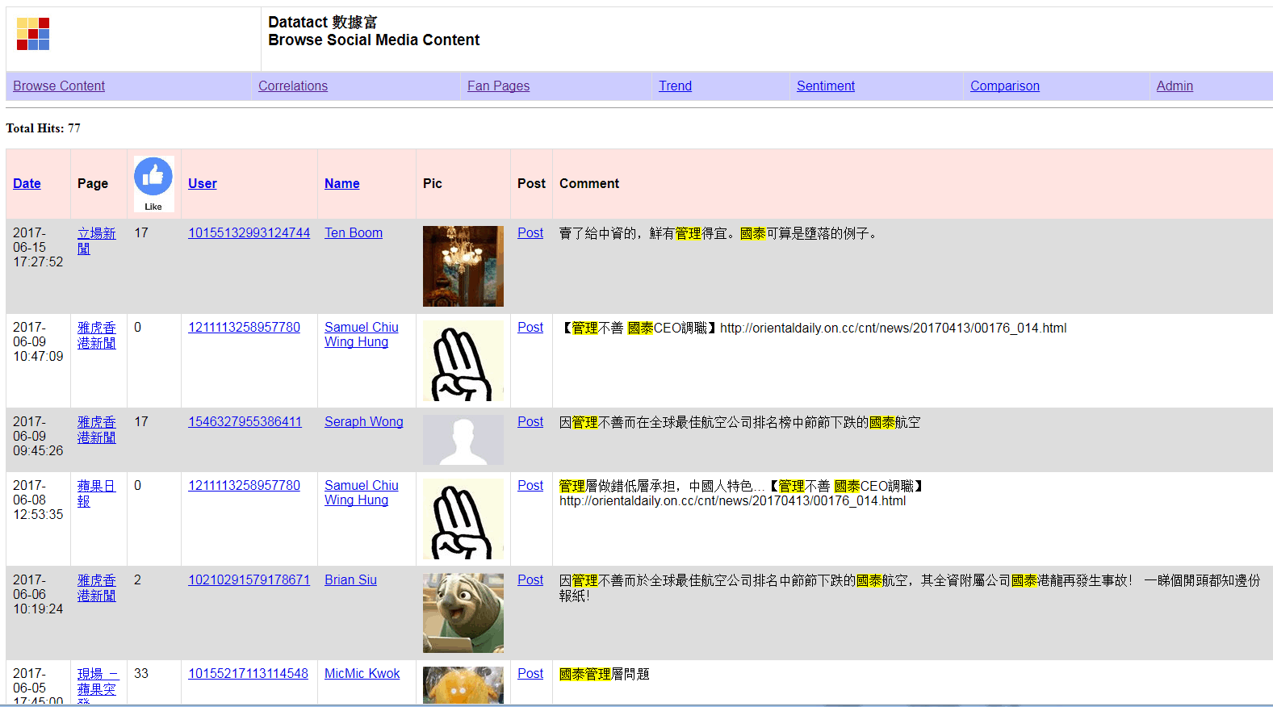
Datatact : Social Listening
Public images of Cathay Pacific
2017/07/12

Slide 35
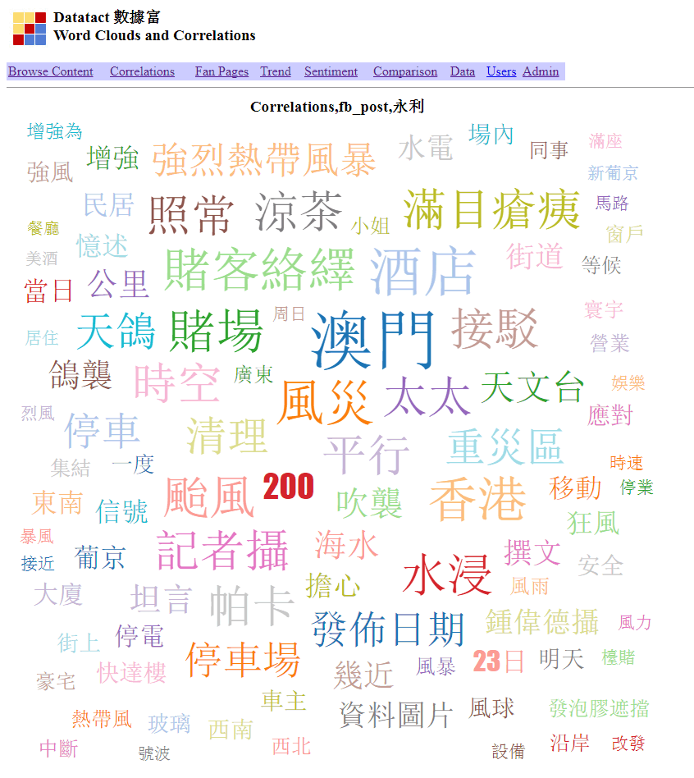
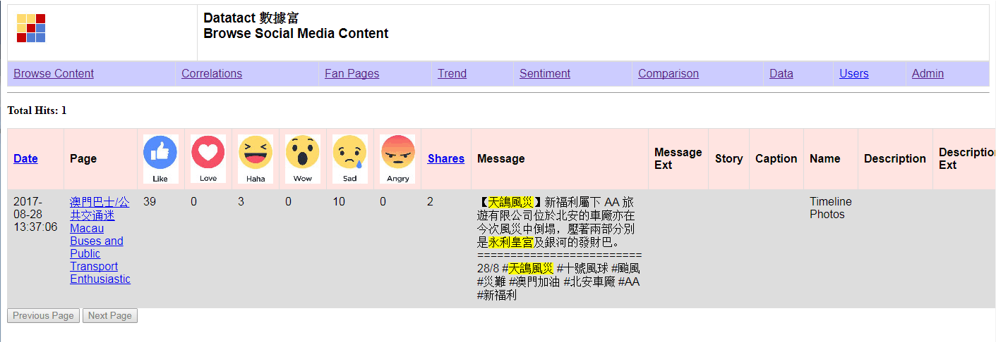
Datatact : Social Listening
Impact of Hato Typhoon to Macau Casinos (Wynn)
2017/08/30

Slide 36
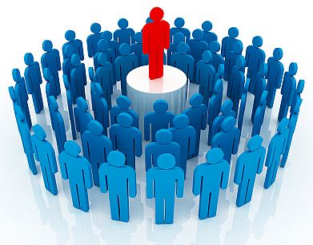
Datatact : Crowd Opinion Leader (COL)
Every customer is also a marketer
Disrupt the marketing industries by linking the brands to the customers directly where the customers are both their marketers and buyers at the same time

Slide 37
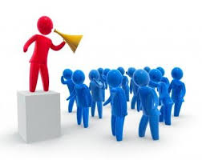
Datatact : Crowd Opinion Leader (COL)
Big Companies: Apart from knowing someone’s interest on a particular brand or product, it’s also important as who’re selling to them. Many people will turn down a promotion from a stranger (sales or marketer). Even if the call/message is from the brand itself, they may consider it as “hard sell”.
Small Companies: Established Companies have been using KOLs (Key People Leader) to promote their brands and products. However, for smaller firms, KOLs are usually too expensive and may not be cost effective. Also, there is no accurate way to measure the effectiveness of an KOL.

Slide 38
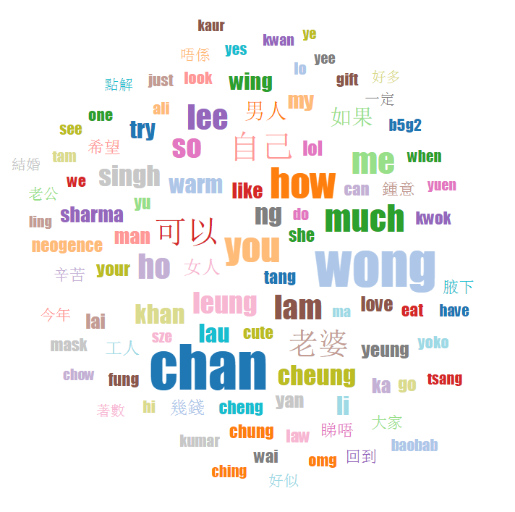
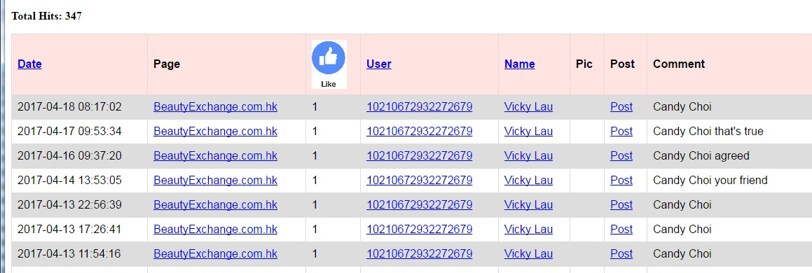
Datatact : Crowd Opinion Leader (COL)
In Social Media (like FB), friends like to tag each for certain brands and products
A word cloud from the 200 Beauty related FB Fan Pages shows that many comments are friends “names”
The details reveal a particular user tagging her friend frequently

Slide 39
Datatact : Crowd Opinion Leader (COL)
Observations
Those users who are actively tagger their friends for products are, in a way, helping to market the brands
Through the network of friends, it would be easier to sell the products as it solved the issue of talking to a strangers
There can be a timing benefit as a friend may know another friend who is currently looking for a particular product
Goals
Turn people into COLs (e.g. our data reveals who are most active on certain categories of products and actively tagging their friends)
Those COLs work for the brands for rewards; while the brands leverage them to increase the sales to their network of friends
Every customer is also a marketer! Linking the brands to the customers directly where customers are both marketers and buyers

Slide 40

Datatact : Crowd Opinion Leader (COL)
COL Identification
COL Profile: trace the user actions
Activity Heat Map: based on the activity metrics which include the frequency of tagging friends, reactions (likes, angry, wow, sad) to particular content or comments
Friend List: number of friends
Goals
Match the COL profile to the appropriate brands/companies
COL matching fee is based on the effectiveness (i.e. the statistics of Activity Heat Map, Feedback Rate and Friend List)
Make the COL exclusively for a company will incur additional charge

Slide 41
Development Pipelines
Facebook & Web Data Extraction
Storage (Database)
Pre-process: Cleaning, Small Caps, Tokenize
Post-process: Remove StopWord, Word Stemming
Index
Search Query
Relevance and Sorting
Visualization & Interpretation

Slide 42
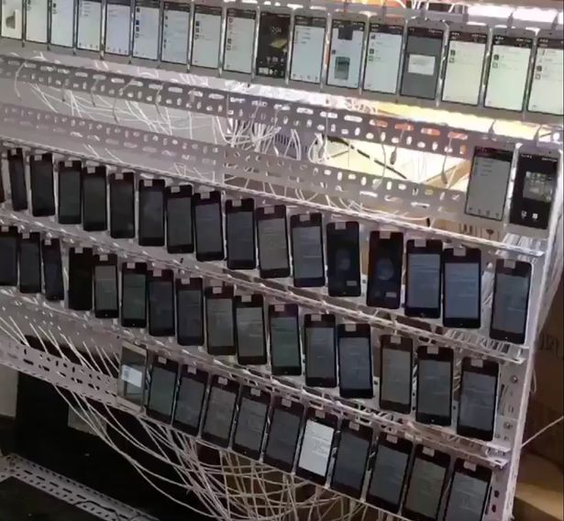
Data Extraction & Storage
Data Extraction
Manage Facebook account
Disconnect and retry
Throttling
Web Scraping
Privacy limitation (Cambridge Analytica Scandal: Facebook Allowed Firm To Exploit Data To Target American Voters)
Storage
Durable
Handle concurrency (multiple writer)
Fast retrieval

Slide 43
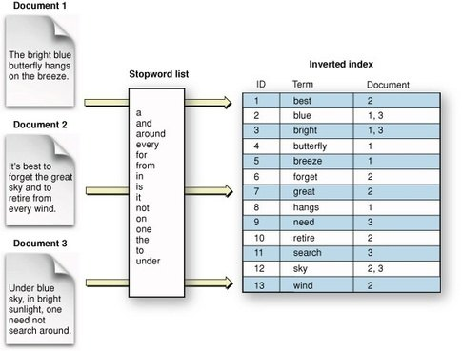
Indexing
Searching:
Inverted Index

Slide 44
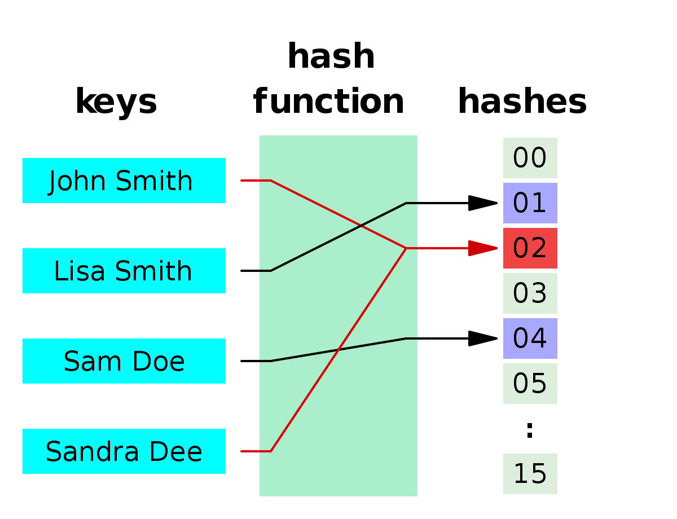
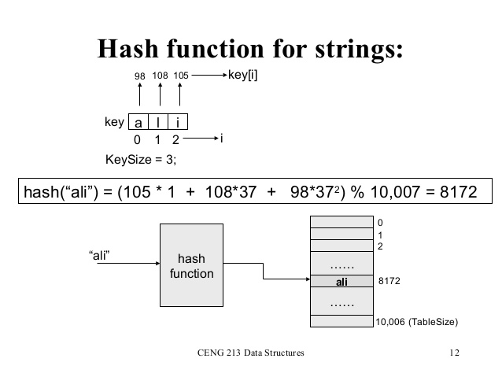
Hashing
Indexed by Calculation
One computer cannot host all the data and need to distribute into multiple computers (clusters of computers)
Hash function determine what data to store in which computer

Slide 45
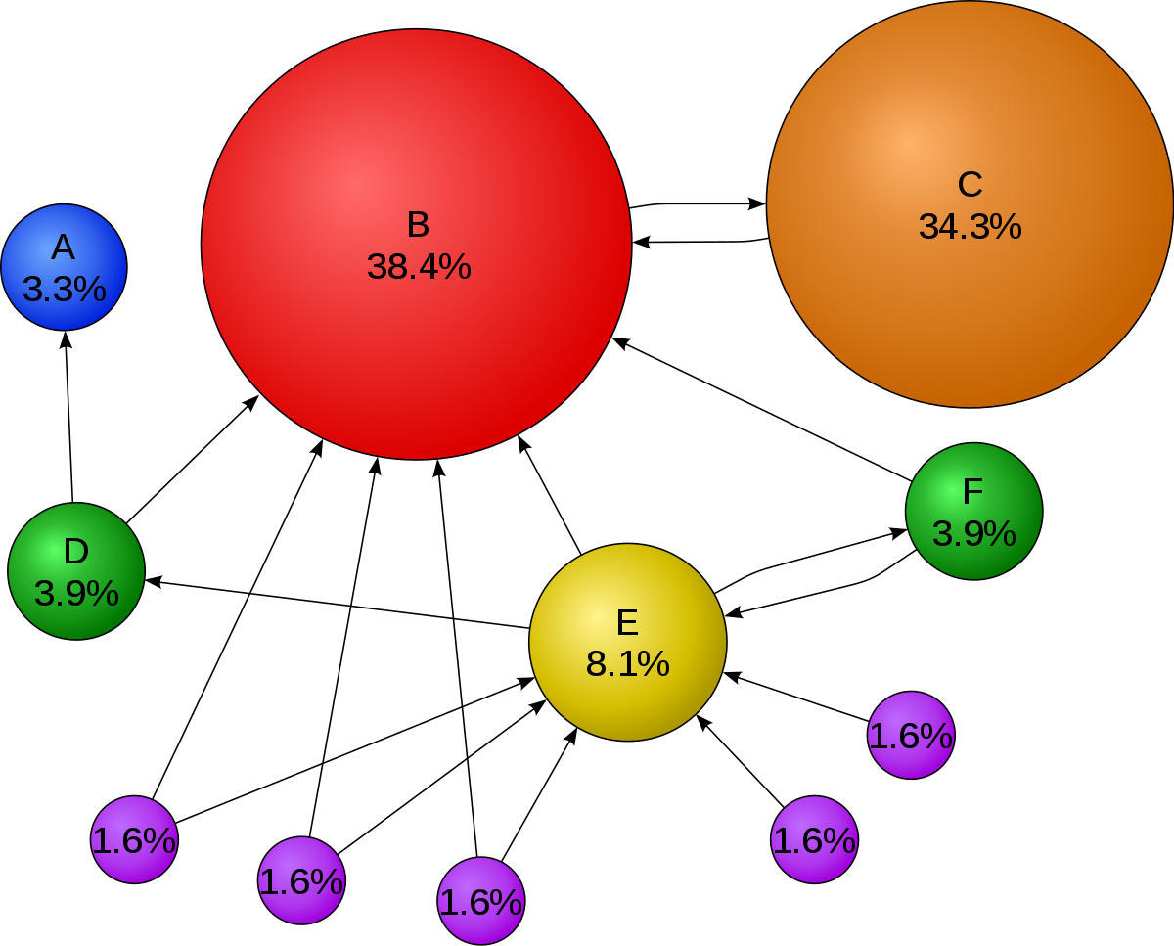
Relevance: Google PageRank
Google realized that relevance for the web depended on trust, not just text
Search Engine Optimization (SEO): https://en.wikipedia.org/wiki/Search_engine_optimization

Slide 46
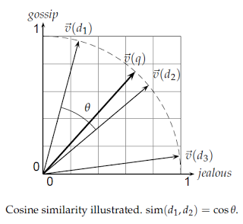
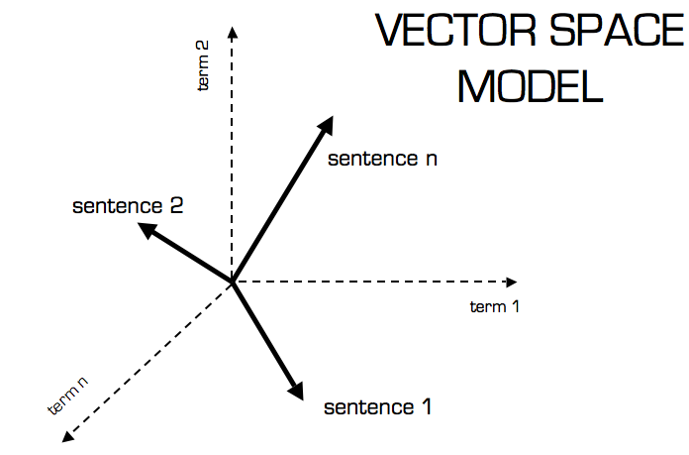
Relevance: Vector Space Model
Representing text documents as vectors of identifiers. Each dimension corresponds to a separate term. If a term occurs in the document, its value in the vector is non-zero.
Use cosine similarity (e.g. dot product) to calculate the text similarity
Demo: http://projector.tensorflow.org/ Example: Search “大交合”

Slide 47

Trading Strategies – HK Warrant
Objective: Try to follow a “super trader” action (recall Social Trading) and profit from it.
Enter Trade when "super user" trade (when a single trade of notation greater than certain amount on a warrant and ask price move up (>= 1 tick) within 10ms to 5s
Exit Trade in these 3 modes
1: Profit mode: Sell if bid + 2 ticks >= avg px
2: Stop Loss: avg px - bid >= 3 ticks
3: Time mode: 15 mins before market close
Canberra Blackjack Experience for the 3 ticks stop loss

Slide 48
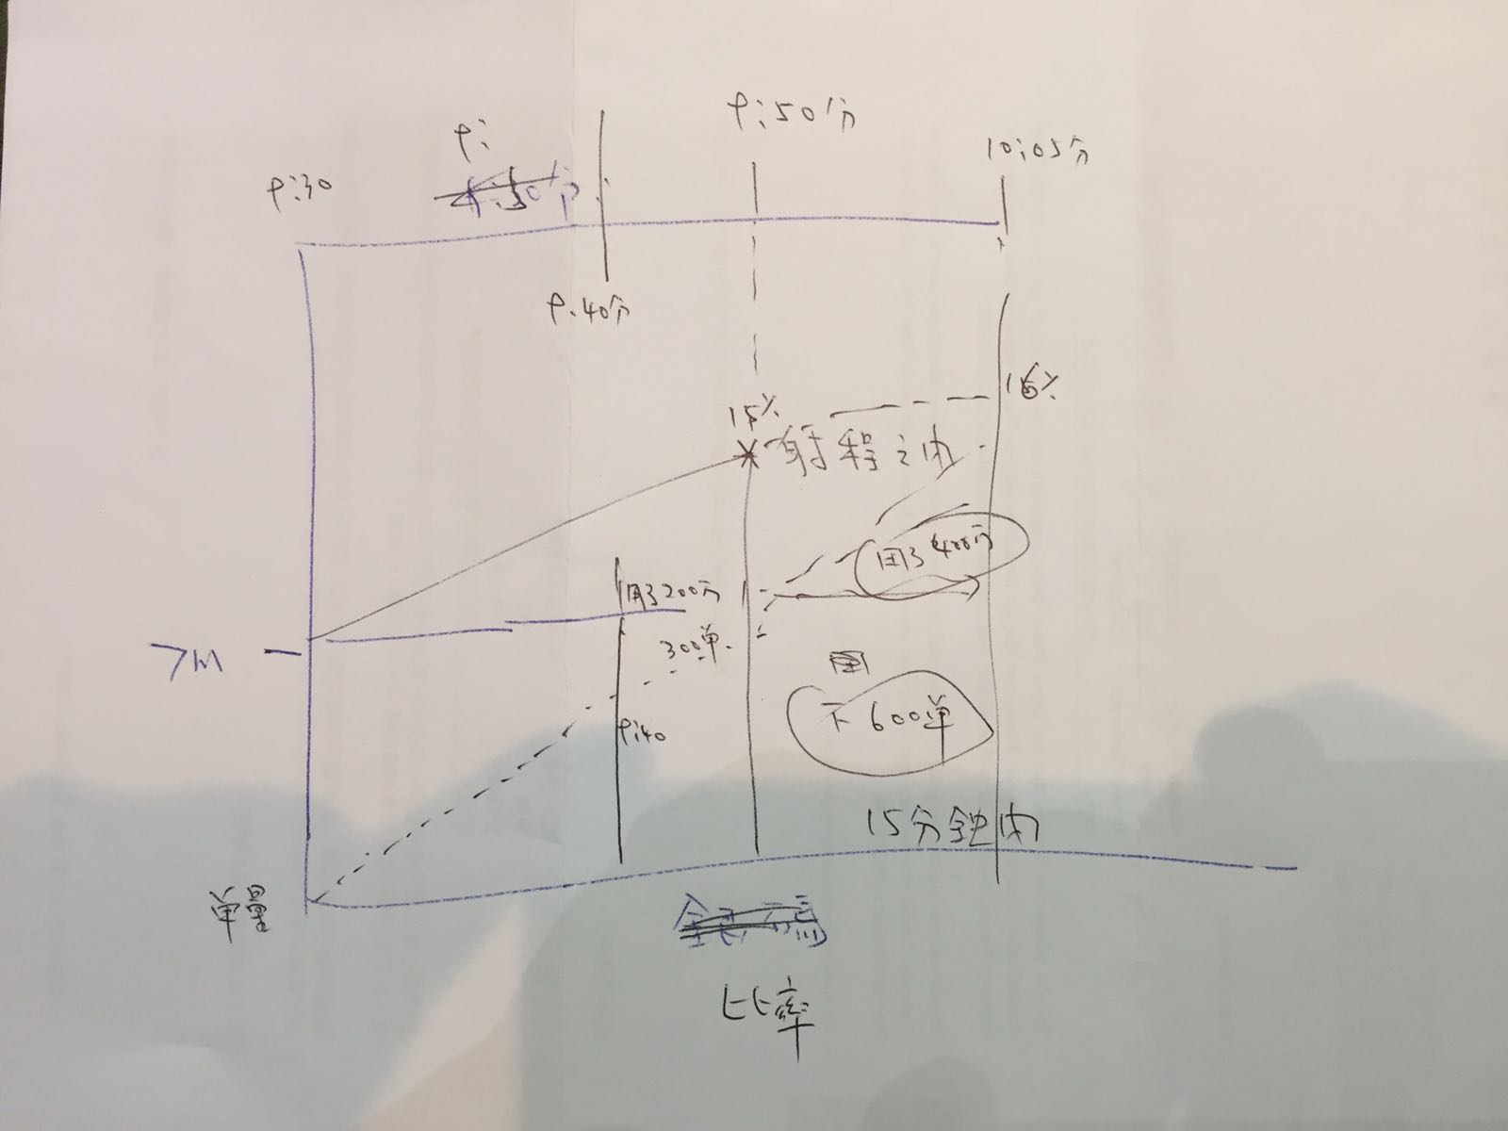
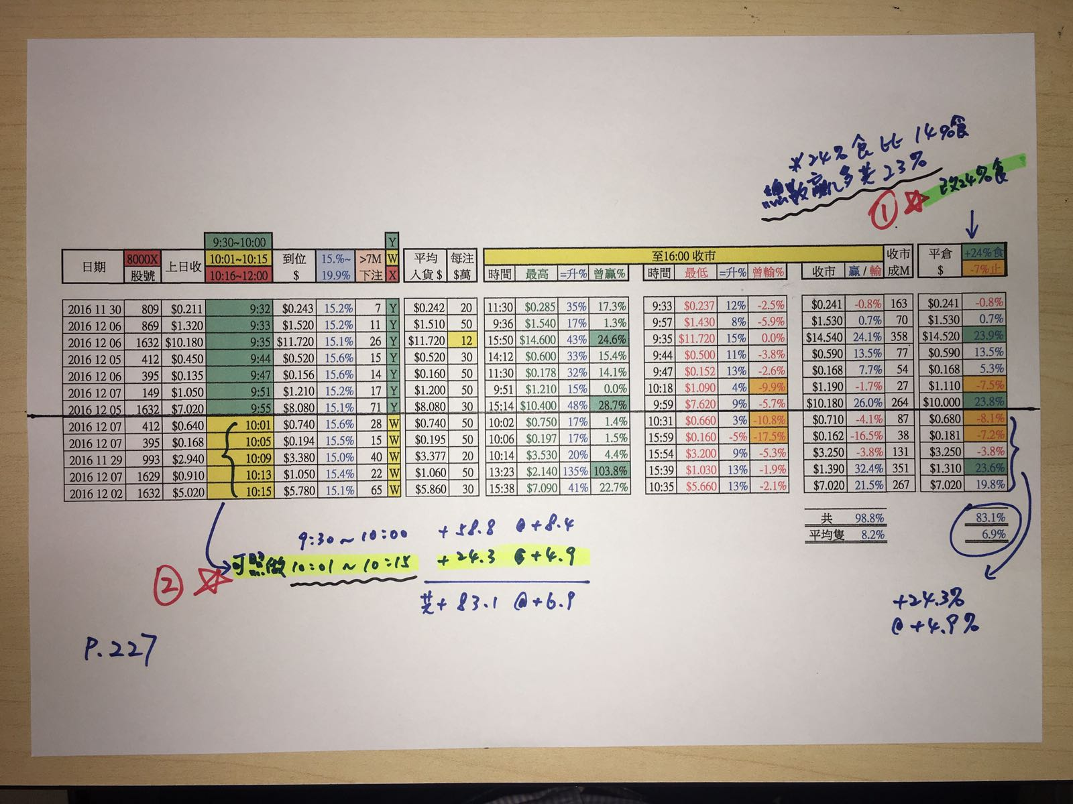
Trading Strategies – HK small caps
Objective: Track abnormal movements for small caps HK names
Daily movement > 10%
Market cap < HK$ 5 billions
Daily volume > HK$10M
No. of trades > 1000

Slide 49
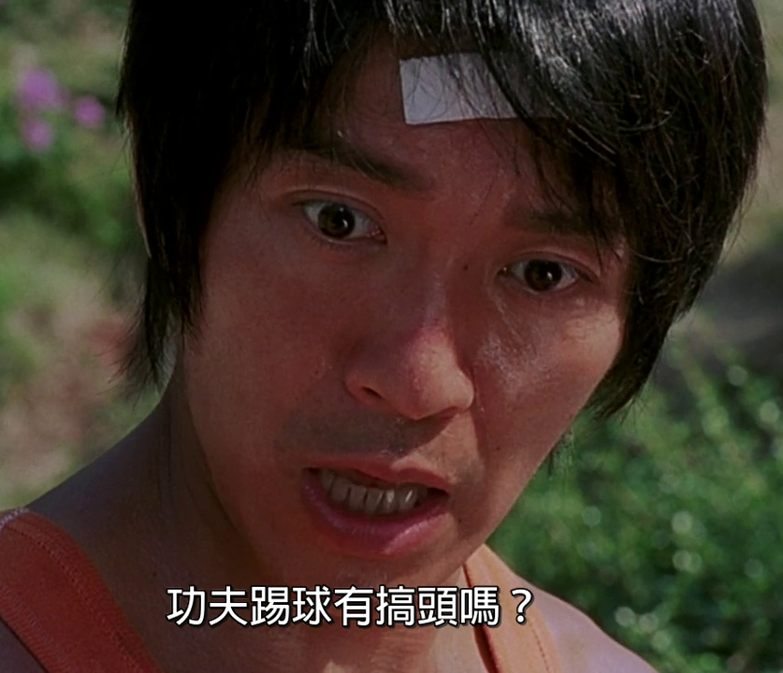
Trading Strategies - Background
AI + Trading = Success ?

Slide 50


Trading Strategies – Trading Charts
Mimic human traders on analyzing charts like Candle Sticks, RSI and Moving average. Generate useful analytics such as classifying the strength of certain signals, spotting anomaly and learning the underlying patters for future predictions.

Slide 51

Trading Strategies – Trading Charts
Put Candle Sticks in time series to spot trends
Depends on the duration of the trend (short-term trend or long-term trend), each candle bar can a 1-min bar, 5-min, 15-min etc. and up to 1-year

Slide 52
Trading Strategies - Trading Charts
Modules: Chart Generator, CNN Clusterer, Classifier, CNN Visualizer and Deep-Q trading.
Traning Data & Features
CNN Visualizer
Historical Tick Data
Chart Generator
CNN Clusterer
Classifier
Deep-Q trading
Human Label

Slide 53


Challenges

Slide 54

Challenges
Overfitting: in-sample training gives high accuracy (false hope) but out-sample accuracy drops significantly
Like Modem Alchemy and just pray it works

Slide 55

Thank you

